Slide 1

Loan_default_prediction
Jinxiang Yu

Slide 2
Problem statement
Maximize profit
Minimize Loss
Profit=Delinquent Loan amount*interest rate
Loss=Unpaid balance upon default
Goal: Improve loan default payment prediction accuracy
Take action on customers who have trend to default (reduce balance)

Slide 3
Explore Data Analysis
Learn about Data Type of Each Column
Calculate missing percentage for each column
Correlation Matrix

Slide 4
Delete columns with >=80% percentage and high correlation

Slide 5
Data pre-processing:
Detect whether missing values is random missing
Fill missing values with null or mean , Create Missing Flags
Encode categorical features
Figure out Boolean values
Check Duplicate Values
Down Sampling
Dropna
Data Scaling
Train Test Split

Slide 6
Model Development
Logistic Regression
Random Forest
XG Boosting
Notes:
LR: More Interpretation
RF: Randomly Select Sample with randomly select feature
GB: Quick learning ability, increase weight to improve weak leaner

Slide 7
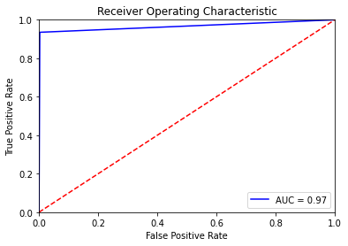
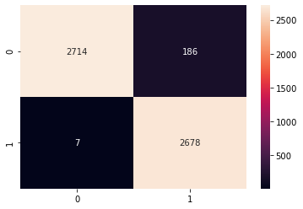
Model Evaluation
Confusion Matrix
ROC/AUC

Slide 8
Model Interpretation
Feature Selection
Random Forest
Xgboost

Slide 9
Conclusion
Model Selection, Random Forest
Model Result
RF: 97% accuracy, 94% precision
Xgb: 91% accuracy, 85% precision
Precision=TP/TP+FP, minimize FP
RF and XGB same accuracy rate, the highest accuracy rate
Random Forest has higher precision

Slide 10
Next step
Tuning Models with Grid Search of Hyper Parameters
Add Fico-score(extremal info of credit history and customer behavior)

